Slide 1
2023 Report

Slide 2
The Australian Compassion Council (ACC) implements the Charter for Compassion, Australia’s aim to Deep Dream Australia A Continent for Compassion through its:
Compassionate Cities Program
National Day of Compassion
Applying Compassion into the Charter sectors
Contributing to the Global Charter for Compassion

Slide 3
Cultivating Compassionate Cities

Slide 4
HEALING COLLECTIVE TRAUMA

Slide 5
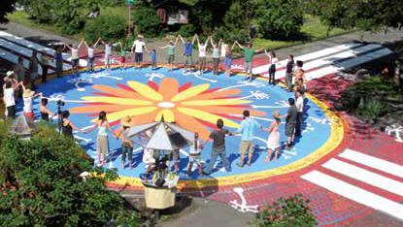
In its Compassionate Cities program, a key focus was on crucial issue of healing collective trauma and the importance of engaging a greater sense of community, as an antidote to the unavoidable trauma in all our lives. A report which included a set of recommendations for local governments was developed and distributed to local governments, and to state & national municipal associations.

Slide 6
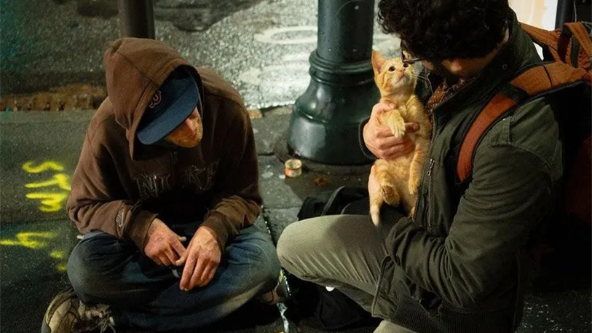
Compassionate Ballarat
As local agencies reported record spikes in the number of people seeking their services, Compassionate Ballarat put together a comprehensive list of services available across its city. With the help of a volunteer, who gave more than 55 hours of his time, this resource provided a ‘one stop shop’ for information on the food, shelter, support and learning services available across Ballarat.
CB Chair Ben Kelly said that ‘..collating this information onto one site, provides agencies and individuals access to a wide range of local services and will assist our residents in feeling supported’. Access support here: https://www.compassionateballarat.com.au/be-nurtured. Copies were also printed and dropped to local water authorities, welfare agencies, community health groups, banks, etc for those without access to the internet.

Slide 7
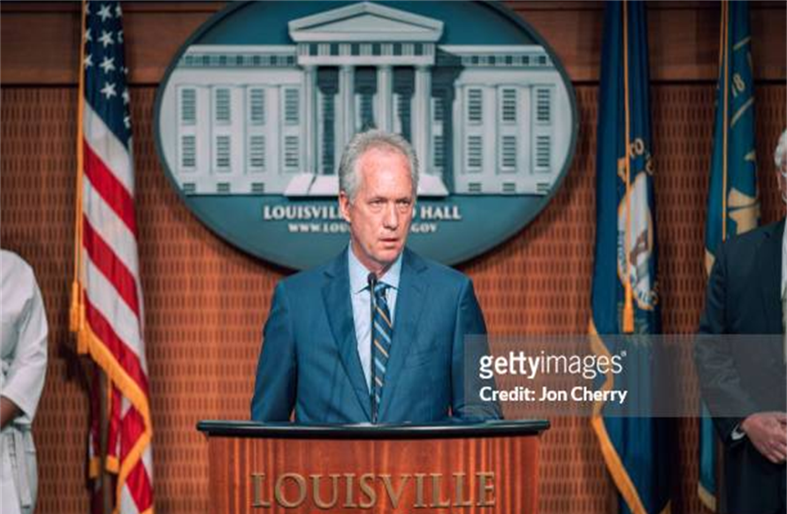
Compassionate Social Infrastructure
A discussion with the former Mayor of Louisville, Greg Fischer was held as part of the ACC National Day. When he was Mayor, Greg established the Centre for Mayors and Business Leaders for Compassionate & Equitable Cities. In 2024 an online forum will be held with the current Chair of that Centre, Mayor Ron Nirenberg as a discussion starter to new approaches on compassionate social infrastructure in Australian cities.

Slide 8
Inspiring COMPASSION IN OTHERS

Slide 9
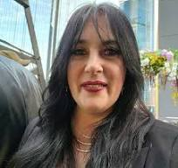
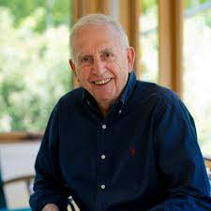
The National Day of Compassion provides an opportunity for all Australians to learn about and practice compassion. In 2023 the Day commenced with a live event that included presentations by the Australian Charter Ambassador - Dr Hugh MacKay on ‘Deep Wisdom in Community’ and by Tania Rossi, the great granddaughter of one of our first female indigenous activists - Aunty Marg Tucker. Tania spoke on ‘Indigenous Insights into Deep Wisdom’.
https://www.youtube.com/watch?v=df0_fAEU0Tg

Slide 10
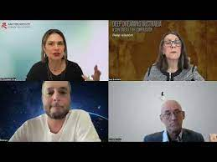
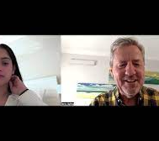
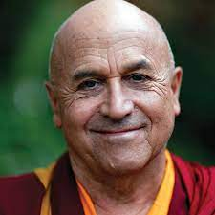
National Day sessions featured international and Australian thinkers reflecting on a wide array of aspects of deep wisdom, including as it applies to the strategic work of corporate boards; to the Buddhist path to wisdom; to how it gets expressed across all age groups; in spiritual leadership in times of crisis; on how wisdom can guide political decision-making; in peaceful transformational change in society; and in creative and futurist thinking in the vital area of education.
https://www.youtube.com/watch?v=xXtyB3dvbfk&list=PLFQpo8As6ohbfBG6pdyK1TPtLy7Hs_xaU&index=5

Slide 11
This year Australians were asked to vote in a referendum on a Voice to Parliament. The ACC ran a ‘Why of the Voice’ project on the basis that, while there was much discussion on the ‘What’ and the ‘How’, there was very little on the ‘Why” of the Voice.
Partners to the Charter were invited to contribute a compelling statement drawing on the five Indigenous mindsets as articulated by Dr Tyson Yankaporta in his book Sand Talk, i.e. Kinship, Story, Dreaming, Ancestor, and Pattern Mind.
Contributors included Shane Howard; Prof Peter Yu AM; Dr Hugh Mackay AO; Dr Ursula Stephens; Margaret Hepworth; Dr Petrina Barson; Lyn Stephens; Peter Yuile.

Slide 12
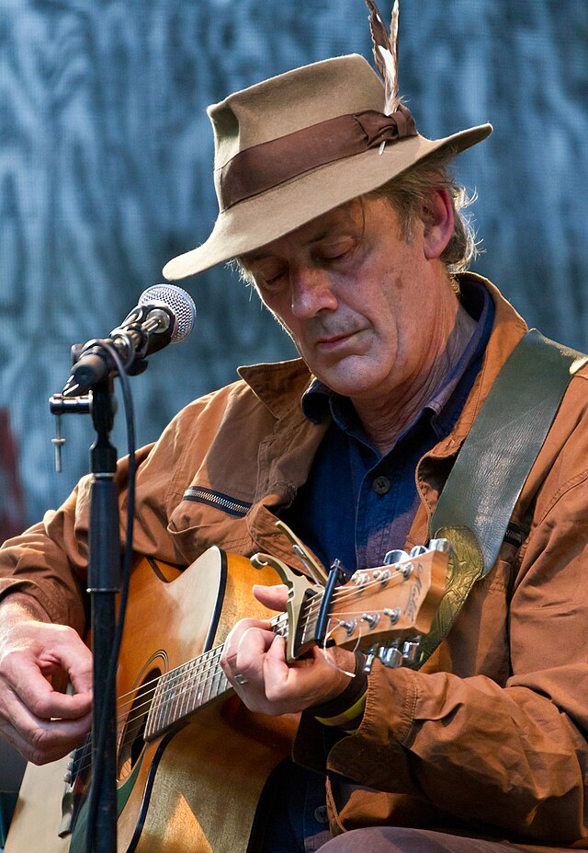
following the failure of the Referendum, ‘with ‘deep sadness’ - Shane Howard Returned his OAM AWARD - in the Why of the Voice, he wrote
At its heart, this is an Aboriginal country. First Nations people watched ice ages come and go. Ancient Songlines re-enact the deep history of the oldest continuous culture and spirituality on Earth, calling us to address the fundamental lie at the heart of our national story. Aboriginal philosophy and cosmology offer a great gift if we but listen and give voice.
When I wrote the song, ‘Solid Rock’, I dreamt of a country respectful of our ancient history and honest about our modern history. I wanted to be proud of my country. Now, we have the chance, to be an honourable example in a confused world. ‘Voice’ is the first aspect of a triptych: ‘Voice, Treaty, Truth.’ What possible good could come from a ‘No’ vote?

Slide 13
NURTURING COMPASSION HEROES

Slide 14
This year’s Compassion Heroes book collected inspiring stories of acts of compassion from school students.
These stories are important because as Year 9 student Nivash Neil outlines at the beginning of this book – in today’s fast-paced, digitally driven world, storytelling remains just as relevant as it has always been. In fact, it has become even more important in a world where we are often disconnected from one another and seeking ways to connect and understand others.

Slide 15
Championing COMPASSION SCIENCE

Slide 16
ACC SCHOLARS NETWORK
Co-founders of the Scholars Network, Prof Felicia Huppert and Dr Lynne Reeder continued to update its members on new aspects of compassion science; the editorial team of the Australian Journal of Management Special Issue on Compassion in Organisations progressed the peer review of submitted articles; and its 2023 conference featured presentations by Prof Michael West, Lancaster University, UK; Prof Narelle Lemon, Edith Cowan University; Dr Liz King, The University of Sydney.

Slide 17
Advocating For compassion IN ACTION

Slide 18
Role of Compassion in Climate Change
The ACC partnered with the Women’s Climate Congress on ACTION 6 of its Charter for Change: Elevate compassion and kindness in government.
A joint seminar was organised with Jamie Bristow of the UK Mindfulness Initiative and Prof Christine Wamsler, Lund University, Sweden to discuss the MI Initiative report Reconnection: Meeting the Climate Crisis Inside Out - we had hundreds of registrations and recording downloads including by Australian and global NGO representatives and policy makers.

Slide 19
Fostering Global Connections

Slide 20
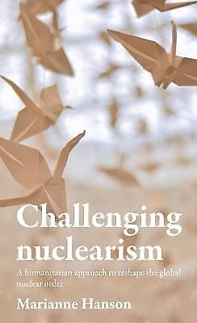
Martin Luther King 40 Days of Peace – 2023 Presentation
On 22 January 2023 Let’s Talk Peace Ballarat and the ACC contributed to the global Charter for Compassion’s MLK 40 Days of Peace program with a discussion by Dr Marianne Hanson, author Challenging Nuclearism: A Humanitarian Approach to Reshape the Global Nuclear Order – Marianne reminded us that there is much each of us can do to support global peace.
https://www.youtube.com/watch?v=d7ldw66Atl0

Slide 21
The ACC contributed to the work of the Global Compassion Coalition. The GCC was established by Dr Rick Hanson to bring together organisations across the world with an interest in the science and spirituality of compassion.
Dr Lynne Reeder was invited to present at its forum on compassion and climate change, which also featured the internationally renowned systems scientist, Peter Senge.
The presentations explored how fostering compassionate mindsets can be a catalyst for creating the conditions necessary to tackle climate change and pave the way for a sustainable future.

Slide 23
Charter for Compassion, Australia has partnered with Compassionate USA - and as partners we were able to include one of the US founders, Ann Helmke in our ACC National Day presentations. Compassionate USA was formally launched at the June 2023 Meeting of the US Conference of Mayors. Compassionate USA seeks to help people develop foundational skill-sets, a shared vocabulary, and a common practice for all people to ultimately decrease violence and trauma and increase individual and collective healing. Compassionate USA is a member of the global Charter for Compassion.
https://compassionateusa.org/

Slide 24
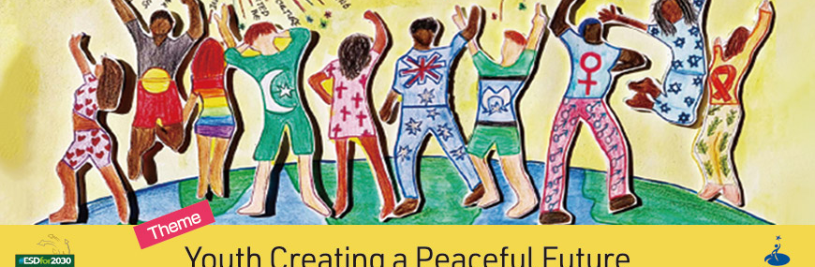
The Goi Peace Foundation, based in Japan invited members of the Australian Compassion Council to be judges in its International Youth Essay Competition. The theme for this year was Youth Creating a Peaceful Future. Dr Lynne Reeder was supported by Claire Mahony in reading fifty essays from students in countries around the world, scoring each essay according to its set criteria.

Slide 25
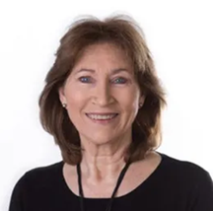
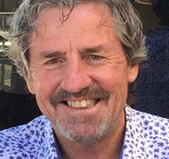
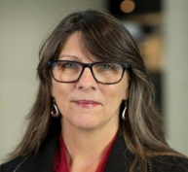
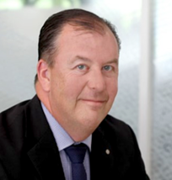
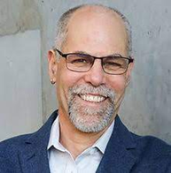
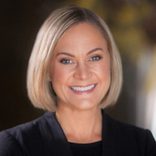
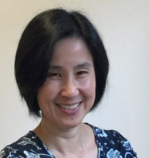
AUSTRALIAN COMPASSION COUNCIL
Dr Lynne Reeder VIC
Terry Ayling QLD
Dr Sue Sumskis NSW
Mark Crosweller ACT
Michael Bartura VIC
Gwen Pinnington TAS
Dr Debbie Ling VIC
www.charterforcompassion.com.au/charter/council

Slide 26
NATIONAL SECTOR COORDINATORS
During 2023 we continued to grow the capacity of the Charter for Compassion, Australia through the wonderful contribution of our national sector coordinators:
Peace Sector - Madonna Quixley
Interfaith Sector - Bishop Philip Huggins
Education Sector - Joanna Giannes
Arts Sector –Sharon Davson
National coordinators bring their strengths to work on one sector, contributing throughout the year to the work of the Charter for Compassion, Australia.

Slide 27
The Charter for Compassion, Australia looks forward to another year of impactful activities in 2024.
If you would like to be involved in, or discuss any aspect of our work - please contact us: info@charterforcompassion.com.au
Special thanks to Phunkemedia for its work on our website.

