Slide 1
COMMON HUMANITY TRAINING Free Webinar 17 March 2021 (12-1pm AEDT) Debbie Ling PhD, Monash University Member of the Australian Compassion Council, Charter for Compassion Australia

Slide 2
Research into compassion is driving the interest in common humanity

Slide 3
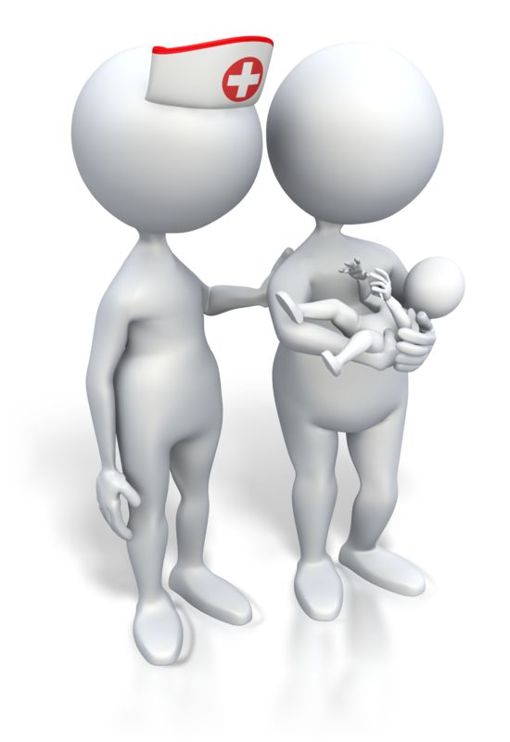
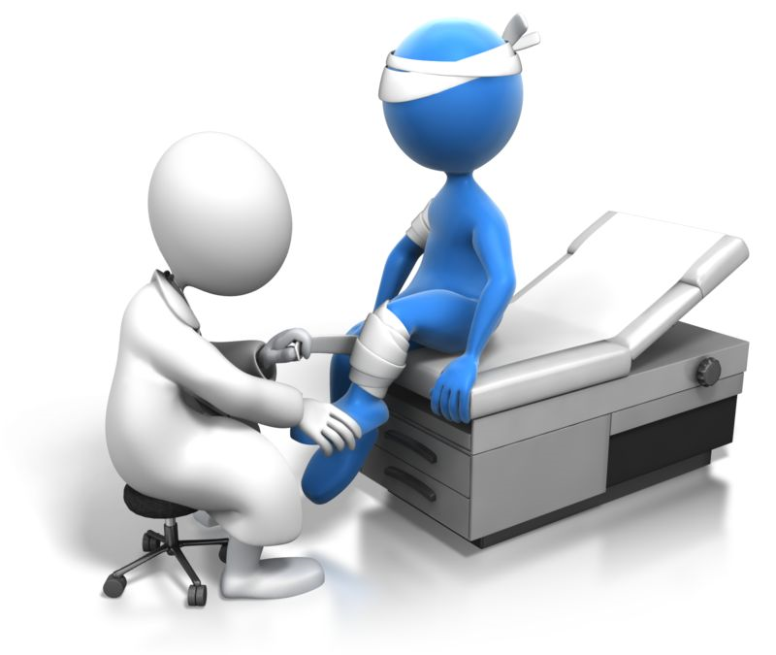
Compassion = concerned response to another’s suffering combined with a desire to alleviate that suffering
Compassion is widely acknowledged as a virtue across cultures.
Compassion is considered to be innate, evolutionary benefit. Even children
as young as 18 months old exhibit compassion to others.
Compassion is the foundation of healthcare and functioning societies.

Slide 4
Compassion research in the last 2 decades
A positive state of mind, leads to feelings of warmth, concern, reward and affiliation (Klimecki et al. 2013; Preckel et al. 2018)
Compassion can be trained (Leiberg et al. 2011, Weng et al. 2013)
Compassion leads to a range of prosocial outcomes including increased caring behaviors, social connectedness, altruism (Hofmann et al. 2011; Mayseless 2011; Preston 2013)
Compassion improves healthcare worker well-being (Fredrickson et al. 2013; Klimecki et al. 2013)

Slide 5
Compassion research in the last 2 decades cont’d
5. Compassion leads to less stress in the caregiver (Dahl, Lutz & Davidson 2015)
Compassion has a positive impact on those who witness and receive it (Kanov et al. 2004)
Compassion reduces the desire to punish the other (Condon & De Steno 2011)
8. Compassion and empathy use different neural pathways (Klimecki et al. 2013)

Slide 6
Common humanity is the perspective that enables compassion for all others
Common humanity has been proposed to be the prerequisite for unbiased universal compassion (Blum 1980; Cassell, 2009; Ling et al. 2018; Nussbaum, 1996).
Common humanity recognises that all people have the same basic needs, wish to be happy and have the same human vulnerabilities e.g. can get sick.
Common humanity leads to an identification with the other, recognition that “Just like me, this person wishes to be happy and avoid suffering” (Jinpa 2016, p.159).

Slide 7
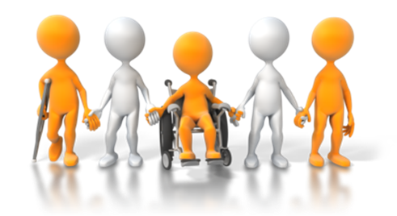
COVID has heightened common humanity
Anyone can get sick at any time, including healthcare workers.
Everyone is someone’s mother, father, son, daughter.
Common humanity is the most inclusive prosocial perspective to hold – all people become the in-group.
It’s a “we” instead of an “us” versus “them”.

Slide 8
Common humanity training content
Education around humans are a social species, evolutionary benefit to cooperation, many animal species cooperate e.g. bees, ants, dolphins, elephants
Humans are born hardwired to connect to others – necessary for survival
Functioning societies require collaboration and working together towards mutual goals

Slide 9
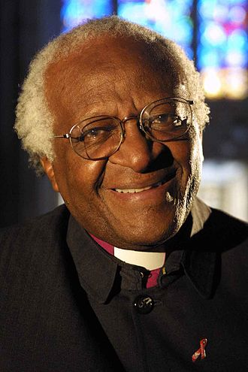
Common humanity training content cont’d
United Nations Universal Declaration of Human Rights (1948)
“All humans are born free and equal in dignity and rights”
Archbishop Desmond Tutu
The profound truth is you cannot be human on your own. You are human through relationship.
We speak by imitating other human beings. We walk as human beings by imitating other human beings.
(Source: Templeton Prize “Who we are: Human uniqueness and the African spirit of Ubuntu. Desmond Tutu, Templeton Prize 2013” Original video: https://youtu.be/0wZtfqZ271w

Slide 10
Common humanity training content cont’d
Golden Rule “Treat others as you would like to be treated” – embedded across cultures and throughout history for several thousand years.
Use of logic and reasoning to guide how we view others & help overcome superficial stereotypes. Easy to categorise people, takes conscious effort to see the bigger picture.
Emphasising similarities (e.g. “everyone wishes to be happy & healthy”) instead of differences. Even if people have different viewpoints, they still have the same needs.
Respecting the person’s fundamental humanity does not mean one condones negative actions. People are still held accountable for their actions. Aiming to try to fix problems, but take hatred out of the equation.

Slide 11
Common humanity training content cont’d
Heightening awareness of interdependence e.g. babies are born completely helpless. Major collective effort to successfully raise the baby to adulthood. Requires a range of caregivers and resources.
Our lives are intertwined with so many others but we don’t normally focus on this e.g. farmers who grow the food, workers who transport it, shop keepers who sell it to us etc.
Useful to acknowledge examples of strangers helping and supporting others e.g.
Thai soccer boys team trapped whilst caving for 2 weeks in 2018 – hundreds of volunteers, diving specialists and rescue response teams from over 18 countries attended.

Slide 12
Reflection
Take a moment to think of all the people who have ever helped, supported or had a positive influence on you in any way whatsoever (not just key caregivers).
It can even be quite a fleeting interchange.

Slide 13
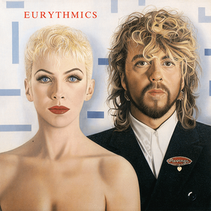
Eurythmics – British pop duo 1980’s
Annie Lennox and Dave Stewart – “Remember those you helped you along the way”

Slide 14
Recognising the source of others’ difficult behaviours
“All unskillful behaviour is the tragic expression of an unmet need” – Marshall Rosenberg, founder of Non Violent Communication.
When people behave in challenging ways, it’s usually because they are afraid of something or worried/anxious.

Slide 15
Common humanity slogans – have it as a screensaver or somewhere visible
“Just like me, this person wishes to be happy and not to suffer” (Jinpa 2016)
“This person is someone’s mother, father, son, daughter”
“Anyone can get sick at any time”
“You today. Me Tomorrow”.

Slide 16
Compassion and connection to others can be easily disrupted
Multiple demands on our attention. Darley and Batson (1973) Good Samaritan Study
demonstrated that self absorption and being in a hurry inhibits tuning into others.
Situational factors are important, emotions are relational, context specific.
Important to be mindful, be able to self-regulate.
Need both self-awareness and social awareness.
Modern life means people have less time to get to know others, easy to jump to
conclusions or make incorrect assumptions about someone else.
Equally, not uncommon for strangers to help each other. Pain is a powerful connector e.g.
if an elderly person trips over in the supermarket, other shoppers usually step in to help.

Slide 17
Compassion and empathy are not the same
Compassion is an other-focused emotion and a positive neural pathway. It arises in response to another’s suffering and encompasses a wish to relieve the other’s suffering.
Empathy – where we are affected by and share another’s emotions – can go down two paths – empathic concern or empathic distress.
1. Empathic concern, which is other-focused, is positive. It is similar to compassion.
2. Empathic distress, where you overidentify with another’s suffering and either imagine their pain or you become distressed by their suffering, is a negative neural pathway. It becomes personal distress. Empathic distress is self-focused.

Slide 18
Empathic Distress Fatigue
The term “Compassion Fatigue” is now understood to be incorrectly named, it is actually “Empathic Distress Fatigue” (Klimecki & Singer, 2012; Ashar et al. 2017)

Slide 19
Understanding the Self ‒ Other Distinction
Be careful, empathy can turn into empathic distress which is self-focused personal distress (painful aversive state)
Compassion is always focused on the other, it is a positive state of mind for the giver

Slide 20
Fact – we need to flick between self and other focus many times per day
Takes practice to stay with compassion rather than accidentally going into empathic distress or burnout.

Slide 21
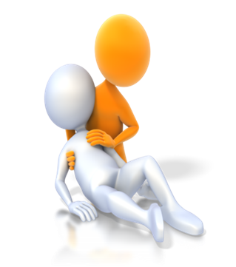
Compassion results in benefits to the giver and the receiver Need to practice a compassionate response to suffering, not always easy as you can get empathic distress (self-focused distress) or you may have habitually practiced avoidance. Try and notice the reward you get when you have compassion (“helper’s high”) to reinforce the benefit to yourself, not just the other. Compassion builds our capacity to manage and respond to other people’s suffering – essential in certain professions e.g. healthcare, teaching etc. Compassion is good for the giver, not just the person who is suffering.

Slide 22
Compassion is a “wish” for the other’s suffering to be relieved, it precedes action
You can still have compassion for someone where you are not successful in directly preventing their suffering e.g. starving children in Africa.
The important point is that the arising of compassion in yourself is still a positive state of mind and better than empathic distress. It builds your capacity for useful responses to another’s suffering. It’s protective against healthcare worker burnout.
Compassion precedes prosocial action, but it’s a fact of life that we can’t always prevent the suffering of others.

Slide 23
The Compassion Process
YES
YES
Empathic distress Exit (Self-focus) YES Empathic concern (Other-focus) Continue “Just like me, this person wishes to be YES happy and not to suffer”
YES
Do I notice the other?
Is the other suffering?
Do I empathise with them?
Do I recognise common humanity?
No one wants to suffer
I wish for their suffering to be alleviated
COMPASSION

Slide 24
Common humanity scenarios
Danish TV2 Advertisement “All that we share” (2017) [8 million views].
Danish TV2 Advertisement “All that we share – connected” (2019)
Australian lifesaver Simon Lewis Interview (2017)
USA prison inmates save the life of a guard prison guard who has a heart attack (2017)
Wes Autrey, father of 2, saves life of fellow subway passenger (2007)

Slide 25
TV2 Danmark (2017) TV 2/All that we share https://www.youtube.com/watch?v=jD8tjhVO1Tc

Slide 26
TV2 Danmark (2019) TV2/All that we share – connected https://www.youtube.com/watch?v=UQ15cqP-K80

Slide 27
Charter for Compassion Australia (2016) Australian lifesaver Simon Lewis helps refugees. https://www.youtube.com/watch?v=bKDbJmBdF-0 (trigger warning shows people in distress)

Slide 28
Qualitative comments from healthcare workers on the Lifeguard video and Danish TV advertisement
“That all of us just want to be loved and live happily”
“Put yourself in their place”
“Find the commonality between myself and another”
“To remember they are ‘just like me’ with the same hopes and fears”
“Try to imagine others’ perspectives, we are all human”
“Looking at common human traits”
“Reflecting on others’ feelings and others’ points of view”
Ling, D., Olver, J., & Petrakis, M. (2018). Outcomes from a Compassion Training Intervention for Health Care Workers. Czech & Slovak Social Work/Sociální Práce/Sociálna Práca, 18(4).

Slide 29
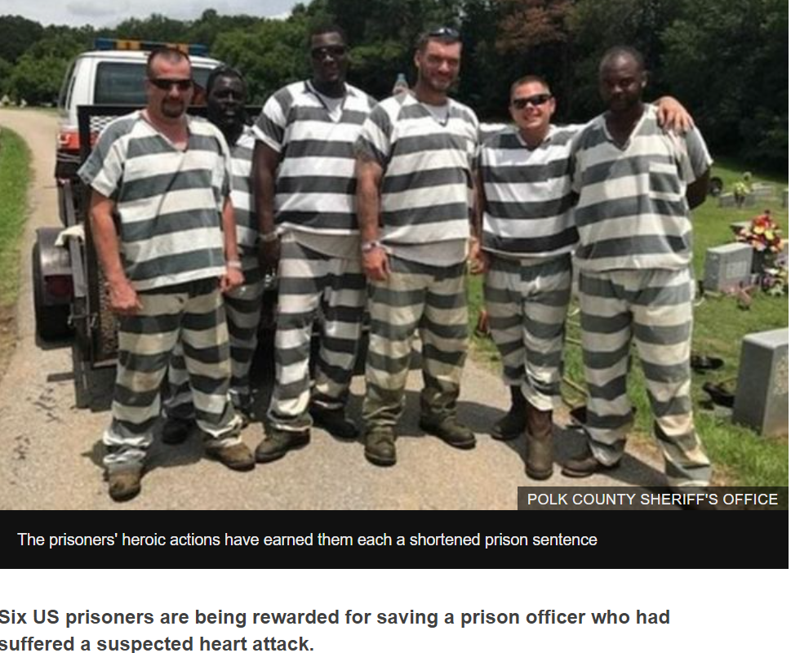
US inmates who saved guard’s life to have sentences cut (2017, June 21) BBC News https://www.bbc.com/news/world-us-canada-40350048

Slide 30
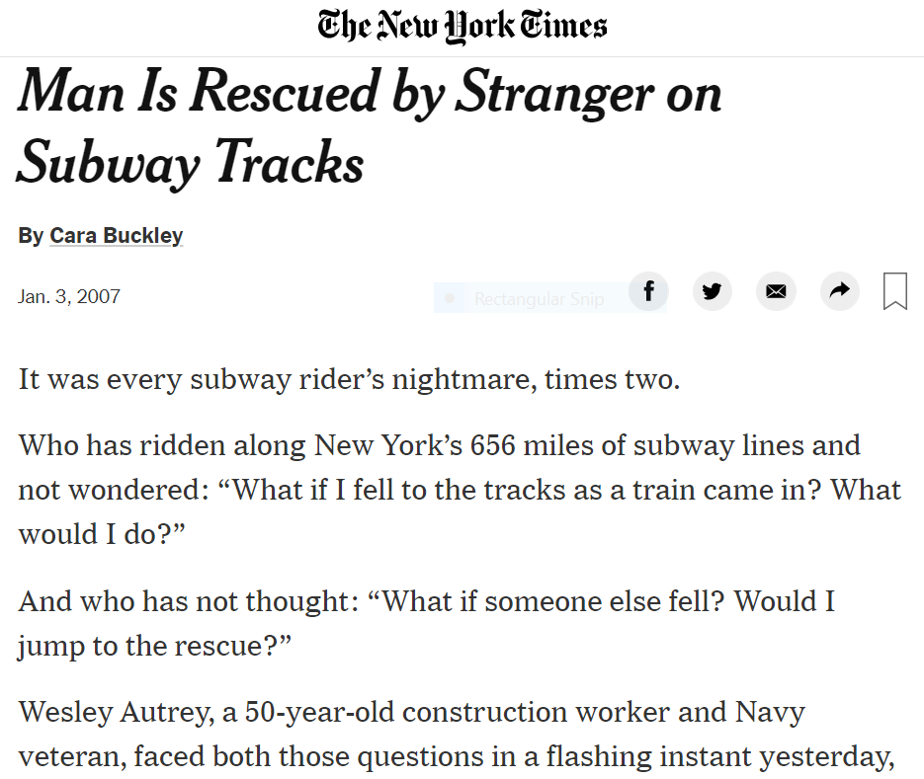
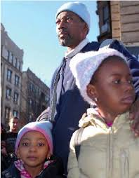
Man is Rescued by Stranger on Subway Tracks (2007, Jan 3) New York Times https://www.nytimes.com/2007/01/03/nyregion/03life.html

Slide 31
Tips for healthcare leaders from the Schwartz Center for Compassionate Healthcare 2020 Conference
Kenneth Schwartz, Founder “Small acts of kindness, to make the unbearable, bearable”.
Spirit of innovation
Willingness to work across systems and silos
Find ourselves doing something different
Remember what healthcare is about – service to others and alleviation of suffering
Not shutting ourselves off, having the heart open, being emotionally sensitive but regulated
Deep respect about the value of the other
Humanity at the heart of healthcare
Cognitive reappraisal

Slide 32
Tips for healthcare leaders from the Schwartz Center for Compassionate Healthcare 2020 Conference cont’d
Consider various models of peer support
Social media is one way to help build connection
Mobile apps, online psychoeducation
Learning how to calm oneself and calm others
Greater communication up and down the line and accurate information
Acknowledge healthcare workers need support too
Encourage staff to utilise available resources
Value of connection and meaning in the work
Scale existing programs – buddy, mentor, wellness
Celebrate small wins and acts of kindness

Slide 33
Compassion Quotes
“If you want others to be happy, practice compassion.
If you want to be happy, practice compassion” – Dalai Lama
“Compassion is the basis of all morality” – Arthur Schopenhauer
“Simplicity, patience, compassion. These three are your greatest treasures” – Lao Tzu
“The purpose of human life is to serve, and to show compassion and the will to help others” – Albert Schweitzer

Slide 34
References
Ashar, Y.K., Andrews-Hanna, J.R., Dimidjian, S. and Wager, T.D. (2017). Empathic care and distress: predictive brain markers and dissociable brain systems. Neuron, 94(6), pp.1263-1273.
Batson, C. D., Eklund, J. H., Chermok, V. L., Hoyt, J. L., & Ortiz, B. G. (2007). An additional antecedent of empathic concern: valuing the welfare of the person in need. Journal of personality and social psychology, 93(1), 65.
Blum, L. (1980). Compassion. In A. O. Rorty, (Ed.), Explaining emotions (pp.507-571). University of California Press.
Cassell, E. J. (2009). Compassion. In C. R. Snyder & S. J. Lopez (Eds.), Oxford handbook of positive psychology (pp. 393-404). Oxford University Press.
Condon, P., & DeSteno, D. (2011). Compassion for one reduces punishment for another. Journal of Experimental Social Psychology, 47(3), 698-701.
Dahl, C. J., Lutz, A., & Davidson, R. J. (2015). Reconstructing and deconstructing the self: cognitive mechanisms in meditation practice. Trends in cognitive sciences, 19(9), 515-523.
Darley, J. M., & Batson, C. D. (1973). " From Jerusalem to Jericho": A study of situational and dispositional variables in helping behavior. Journal of personality and social psychology, 27(1), 100.
Feldman, C., & Kuyken, W. (2011). Compassion in the landscape of suffering. Contemporary Buddhism, 12(01), 143-155.
Fredrickson, B. L., Cohn, M. A., Coffey, K. A., Pek, J., & Finkel, S. M. (2008). Open hearts build lives: positive emotions, induced through loving-kindness meditation, build consequential personal resources. Journal of personality and social psychology, 95(5), 1045.
Hofmann, S. G., Grossman, P., & Hinton, D. E. (2011). Loving-kindness and compassion meditation: Potential for psychological interventions. Clinical psychology review, 31(7), 1126-1132.
Jinpa, T. (2016). A fearless heart: How the courage to be compassionate can transform our lives. Avery.
Kanov, J. M., Maitlis, S., Worline, M. C., Dutton, J. E., Frost, P. J., & Lilius, J. M. (2004). Compassion in organizational life. American Behavioral Scientist, 47(6), 808-827.
Klimecki, O.M., Leiberg, S., Lamm, C. and Singer, T. (2012). Functional neural plasticity and associated changes in positive affect after compassion training. Cerebral cortex, 23(7), pp.1552-1561.
Klimecki, O.M., Leiberg, S., Ricard, M. and Singer, T. (2013). Differential pattern of functional brain plasticity after compassion and empathy training. Social cognitive and affective neuroscience, 9(6), pp.873-879.

Slide 35
References cont’d
Leiberg, S., Klimecki, O., & Singer, T. (2011). Short-term compassion training increases prosocial behavior in a newly developed prosocial game. PloS one, 6(3), e17798.
Ling, D., Olver, J., & Petrakis, M. (2018). Outcomes from a Compassion Training Intervention for Health Care Workers. Czech & Slovak Social Work/Sociální Práce/Sociálna Práca, 18(4).
Mayseless, O. (2016). Caring and meaning in psychotherapy. In Clinical Perspectives on Meaning (pp. 363-381). Springer, Cham.
Monroe, K. R. (1998). The heart of altruism: Perceptions of a common humanity. Princeton University Press.
Nussbaum, M. (1996). Compassion: The basic social emotion. Social Philosophy and Policy, 13(1), 27-58.
Preckel, K., Kanske, P., & Singer, T. (2018). On the interaction of social affect and cognition: empathy, compassion and theory of mind. Current Opinion in Behavioral Sciences, 19, 1-6.
Preston, S. D. (2013). The origins of altruism in offspring care. Psychological bulletin, 139(6), 1305.
Ricard, M. (2015). Altruism: the power of compassion to change yourself and the world. Atlantic Books Ltd.
Strauss, C., Taylor, B. L., Gu, J., Kuyken, W., Baer, R., Jones, F., & Cavanagh, K. (2016). What is compassion and how can we measure it? A review of definitions and measures. Clinical psychology review, 47, 15-27.
Van Der Cingel, M. (2009). Compassion and professional care: exploring the domain. Nursing Philosophy, 10(2), 124-136.
Von Dietze, E., & Orb, A. (2000). Compassionate care: a moral dimension of nursing. Nursing Inquiry, 7(3), 166-174.
Weng, H.Y., Fox, A.S., Shackman, A.J., Stodola, D.E., Caldwell, J.Z., Olson, M.C., Rogers, G.M. and Davidson, R.J., (2013). Compassion training alters altruism and neural responses to suffering. Psychological science, 24(7), pp.1171-1180.

Slide 36
Questions and Answers?
Contact
Debbie.Ling@monash.edu
Mob: +61 4 1811 8853

